Slide 1
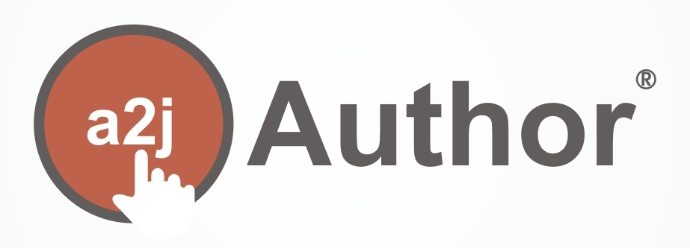
John Mayer
Executive Director
CALI jmayer@cali.org
@johnpmayer
A Decade of Using Document Assembly to Facilitate Access to Justice
Jessica Frank
A2J Project Lead
CALI
jessica@cali.org
@a2jauthor

Slide 2
John Mayer
Executive Director
CALI jmayer@cali.org
@johnpmayer
… and You Can Do This Too!
Jessica Frank
A2J Project Lead
CALI
jessica@cali.org
@a2jauthor

Slide 3

501(c)(3) nonprofit since 1982
200+ US law schools members
Non US law schools, non-profits, and others can join for $250/year

Slide 4
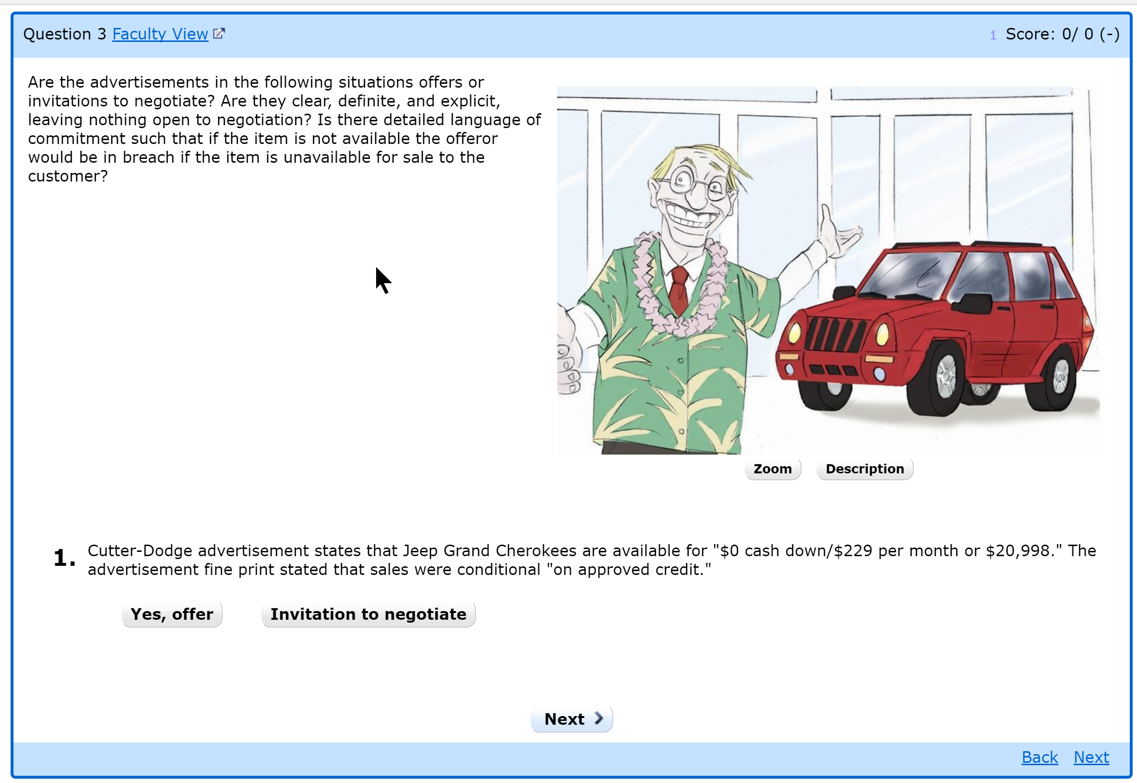

Slide 5
1000+ Lessons

Slide 6
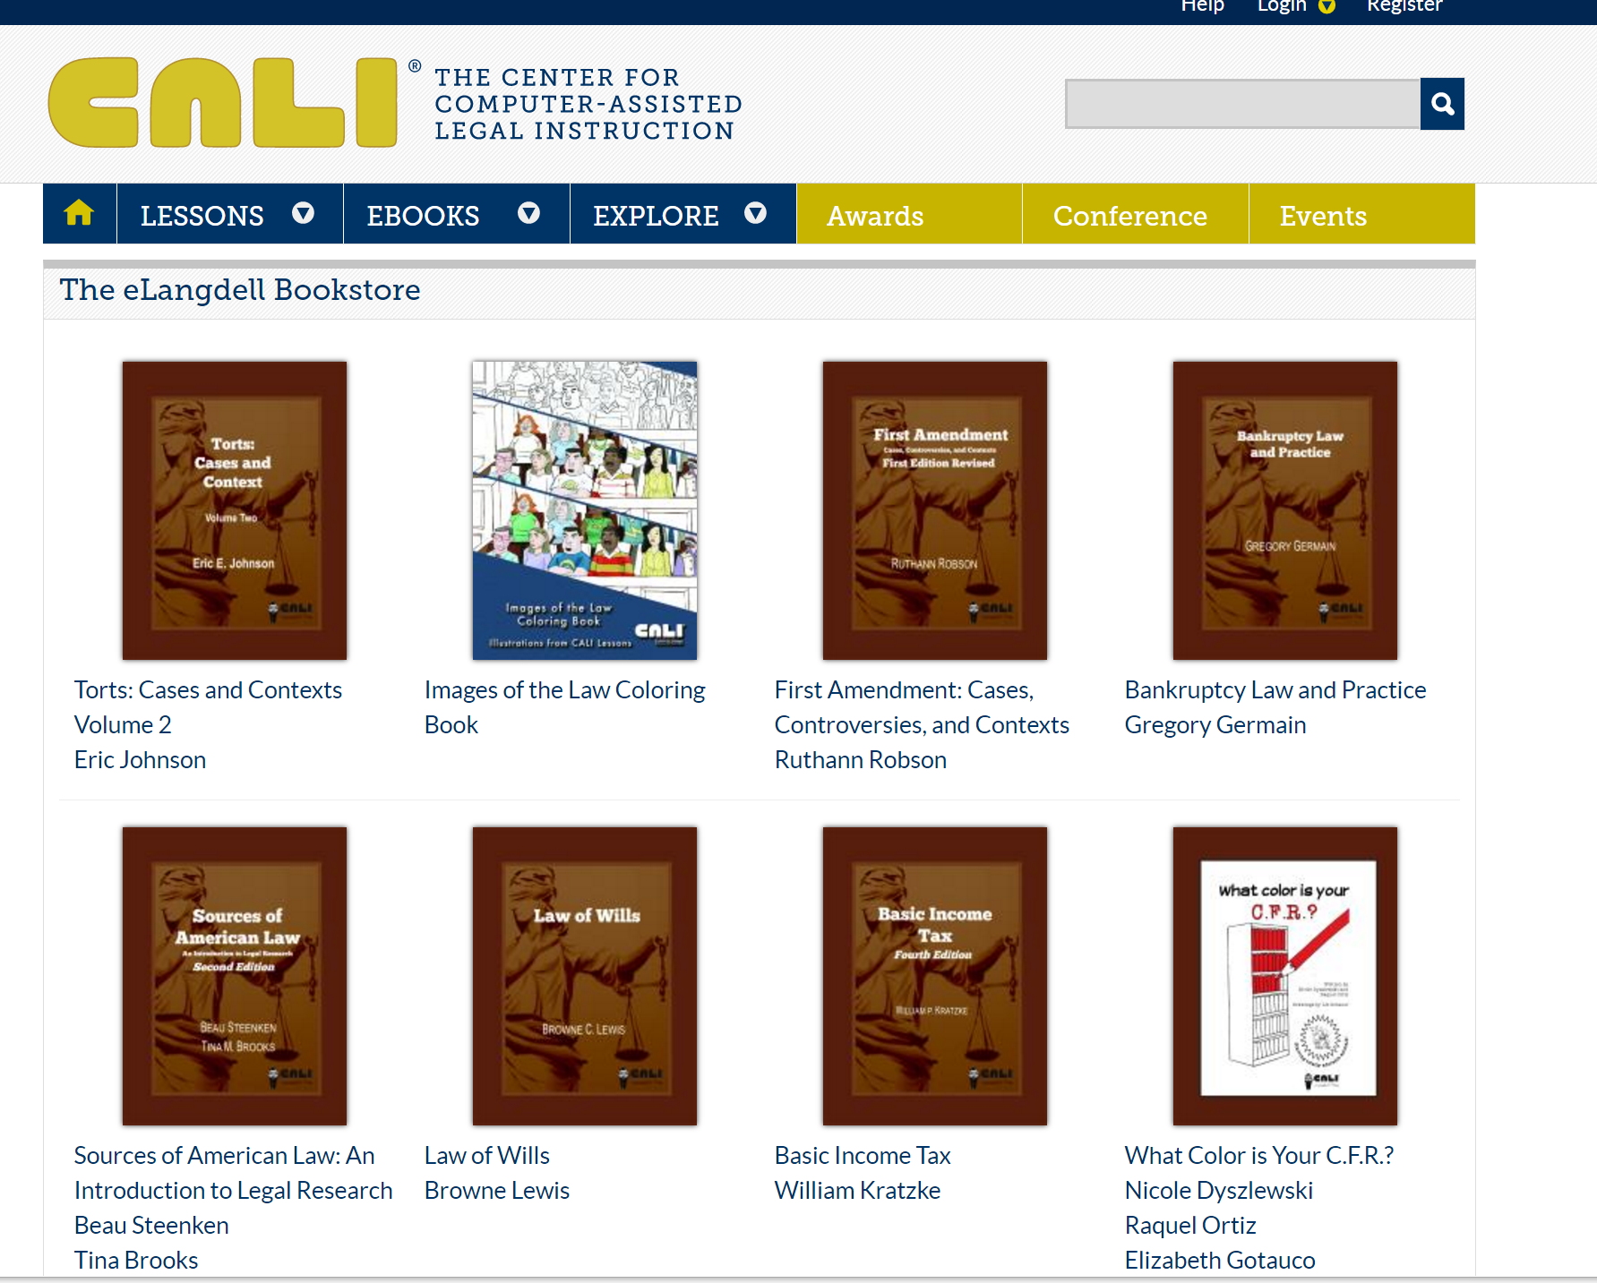

Slide 7
50,000+ Downloads

Slide 8
www.a2jauthor.org

Slide 9
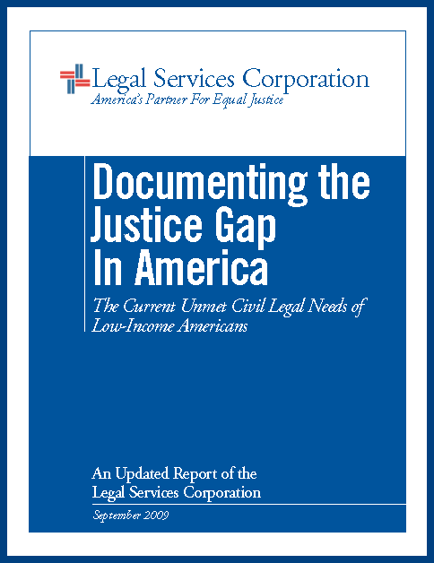
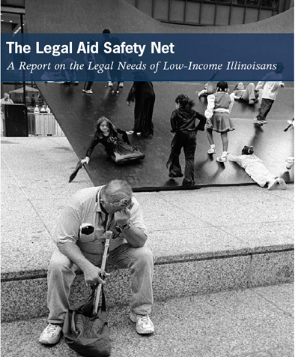
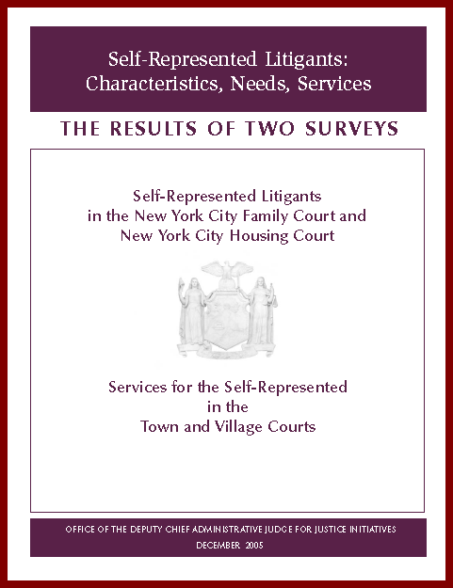
http://www.americanbar.org/content/dam/aba/migrated/marketresearch/PublicDocuments/JusticeGaInAmerica2009.authcheckdam.pdf
https://www.nycourts.gov/reports/AJJI_SelfRep06.pd f
Notes:
http://www.americanbar.org/content/dam/aba/migrated/marketresearch/PublicDocuments/JusticeGaInAmerica2009.authcheckdam.pdf
https://www.nycourts.gov/reports/AJJI_SelfRep06.pdf

Slide 10

  Legal Services Corporation funded agencies complete 1,000,000 cases each year
  Still:
  50% of those seeking legal help at these agencies are turned away
  80% of the poor and working poor in the United States face their legal problems without the help of a lawyer

Slide 11


Slide 13
$%$#@$!!

Slide 14

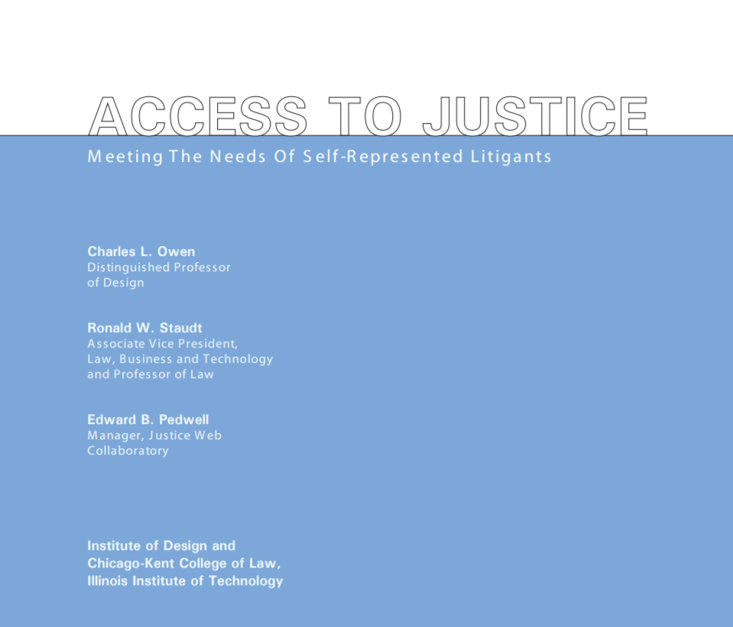

Notes:
Way back in 2001, Chicago-Kent College of Law and the Institute of Design and CALI studied this problem deeply and identified over 200 obstacles – and therefor opportunities to improve people’s use of the justice system.

Slide 15
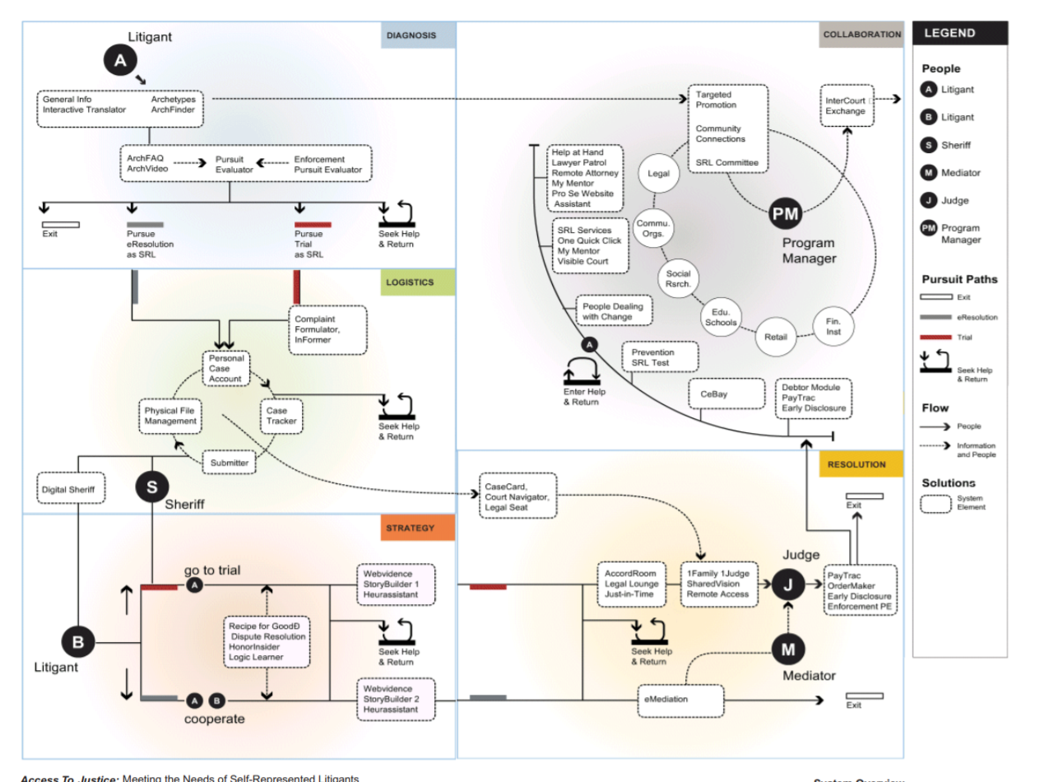
2001
DESIGN
+
LAW
+
TECH
Notes:
Way back in 2001, Chicago-Kent College of Law and the Institute of Design and CALI studied this problem deeply and identified over 200 obstacles – and therefor opportunities to improve people’s use of the justice system.

Slide 16
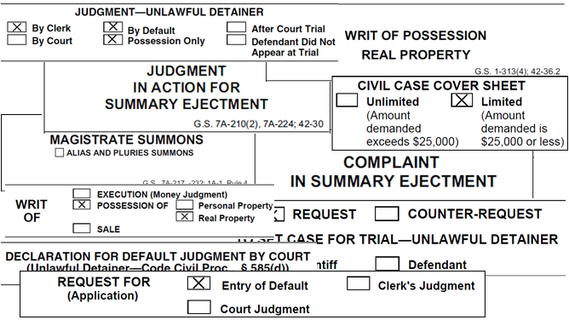
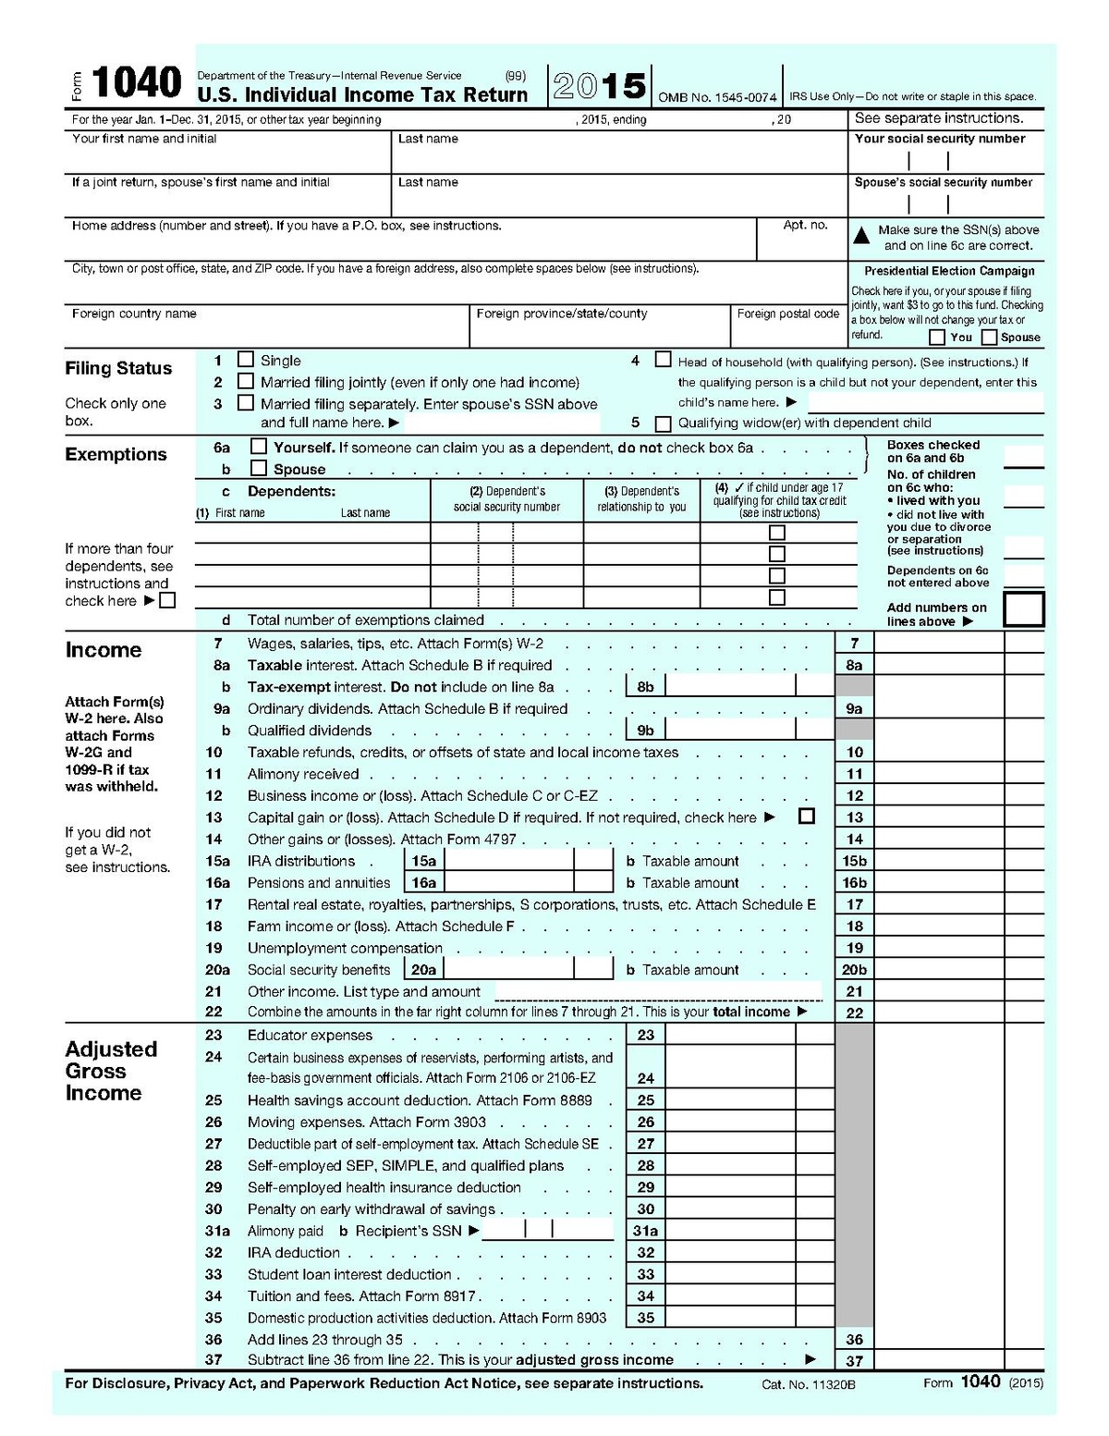
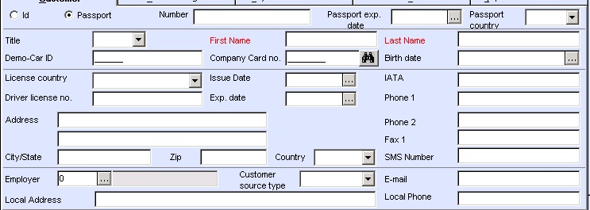
12
Notes:
The key and perhaps obvious observation is that poor people have trouble filling out legal forms. As a group, SRLs are less educated, likely that English is their second language, stressed out and … not lawyers. They are in an unfamiliar and hostile place.

Slide 17

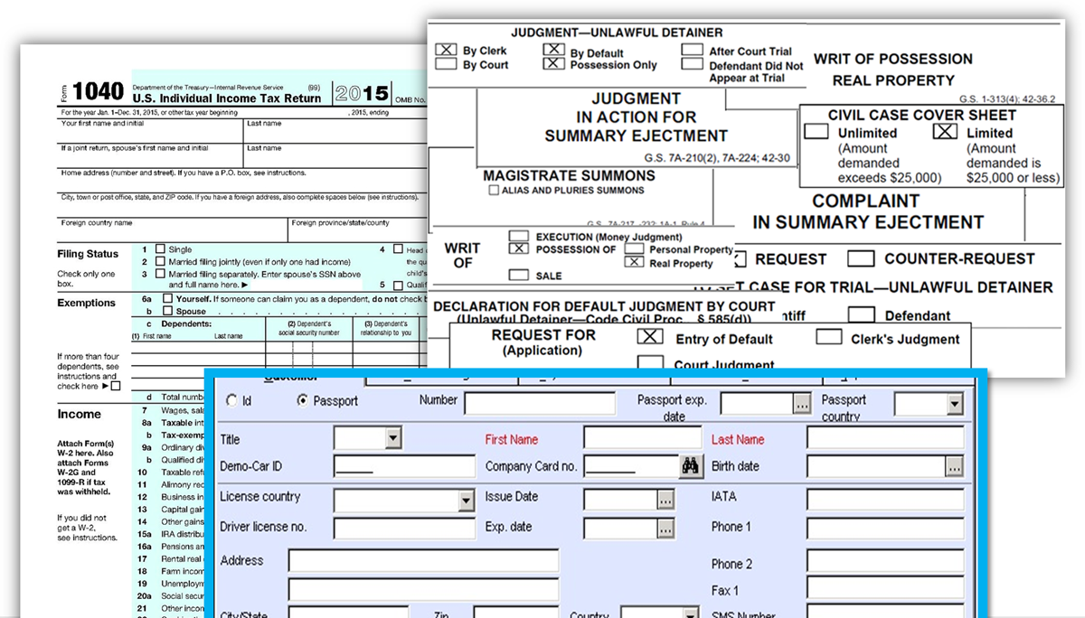


Judges &
Clerks
SRLs
Lawyers
Notes:
Forms are the structured communications of the justice system. They are precision packages of information that are their own language of how courts, judges, lawyers, government bureacracy (especially) talks to itself and the outside world.

Slide 18
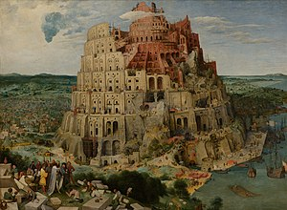
Judges &
Clerks
SRLs
Lawyers
Notes:
Forms are the structured communications of the justice system. They are precision packages of information that are their own language of how courts, judges, lawyers, government bureacracy (especially) talks to itself and the outside world.

Slide 19
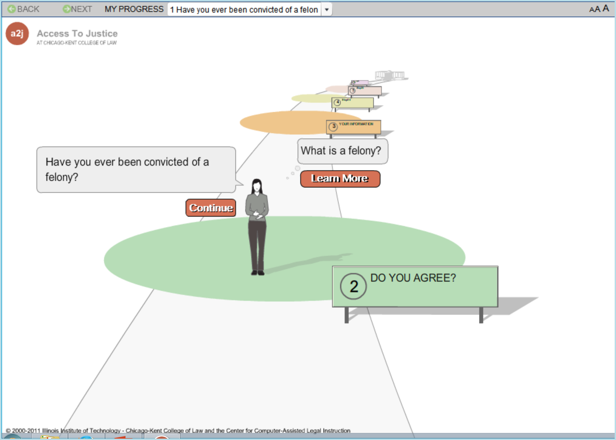

2005!
Notes:
So we designed and coded an application called A2J Author that makes it easier for SRLS to fill out legal forms. Kinda of like LegalZoom for poor people – LegalAidZoom! Lots of white space. One question at a time. Popup help. Small amounts of text per screen.

Slide 20
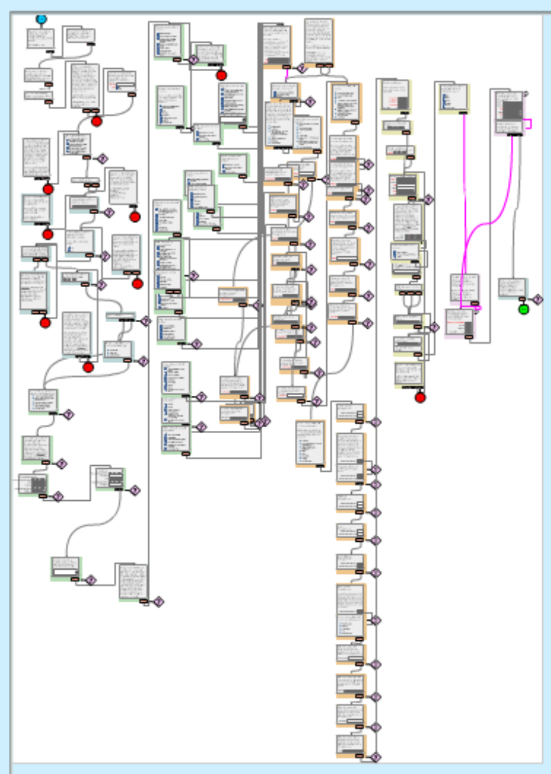
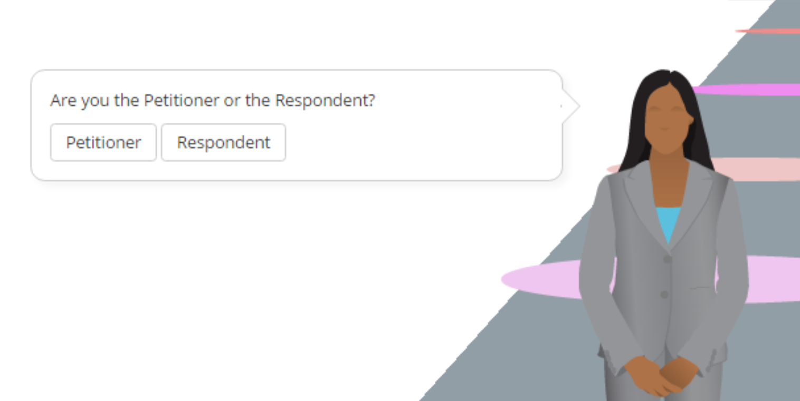
Web-based authoring system that lets lawyers automate legal processes/court forms without programmers

Slide 21

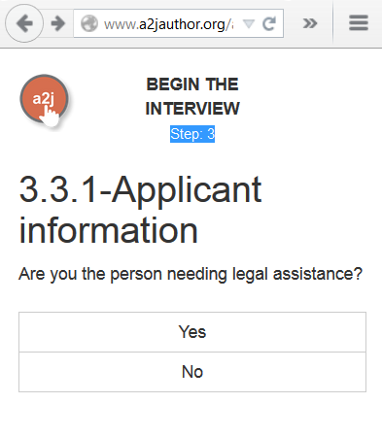
One question at a time - like TurboTax or LegalZoom
2017

Slide 22
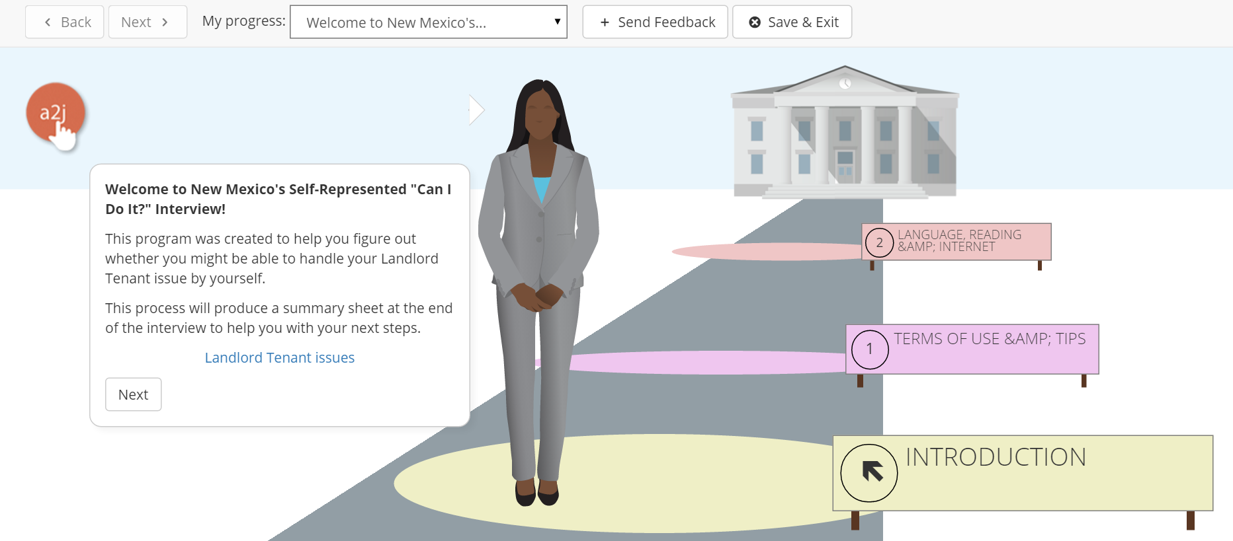
UI/UX designed for self-representing people (mere mortals)

Slide 23
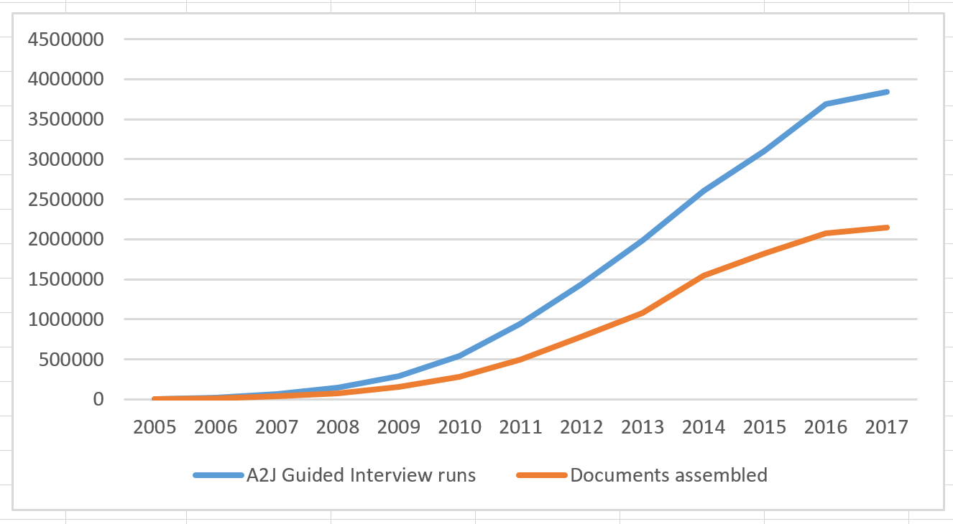
4+ Million usages in last 10 years

Slide 24
4+ Million usages in last 10 years

Slide 25
Free for legal aid, courts, law schools, non-profits serving access to justice

Slide 26
Demo Time

Slide 27
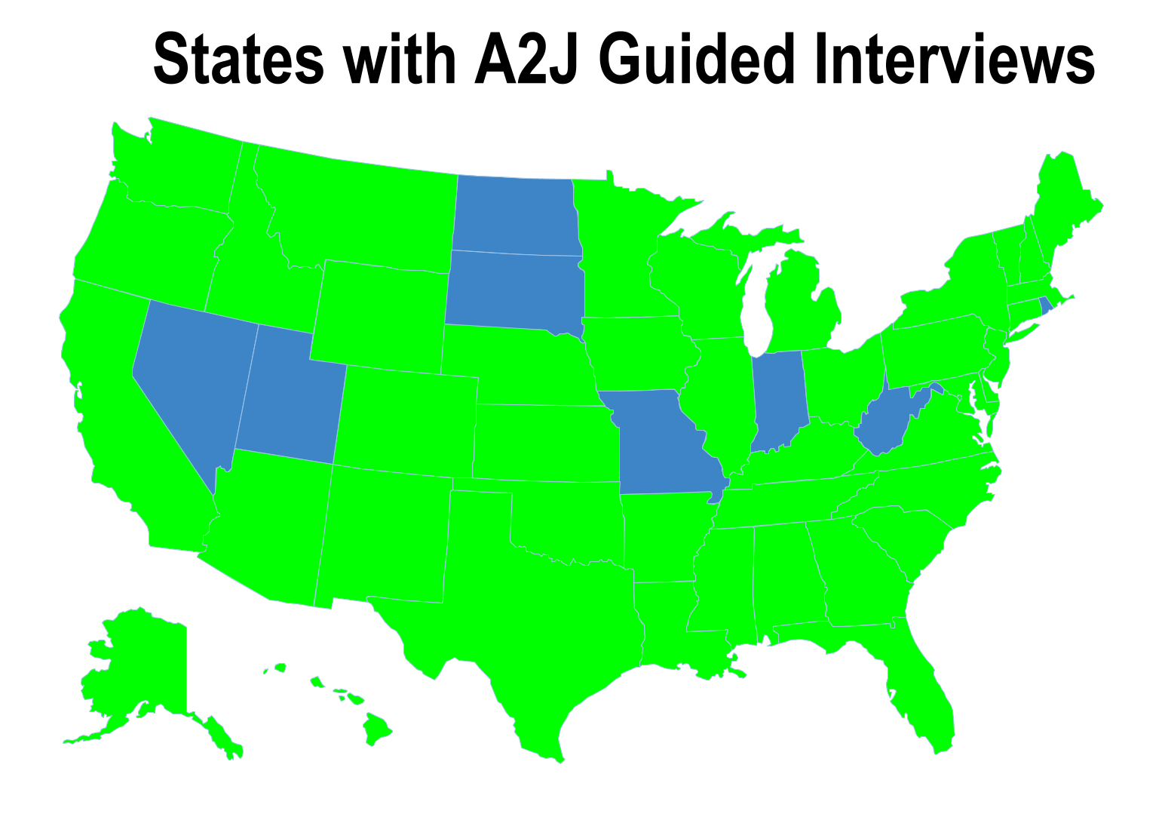

Slide 28
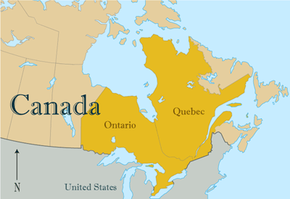
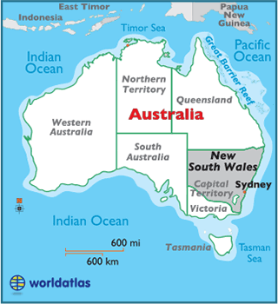
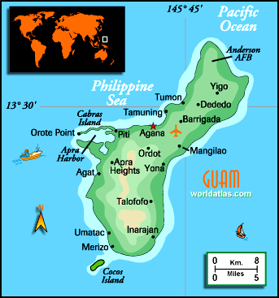
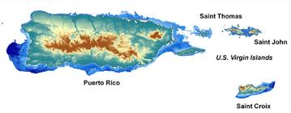
A2J Author Around the World

Slide 29
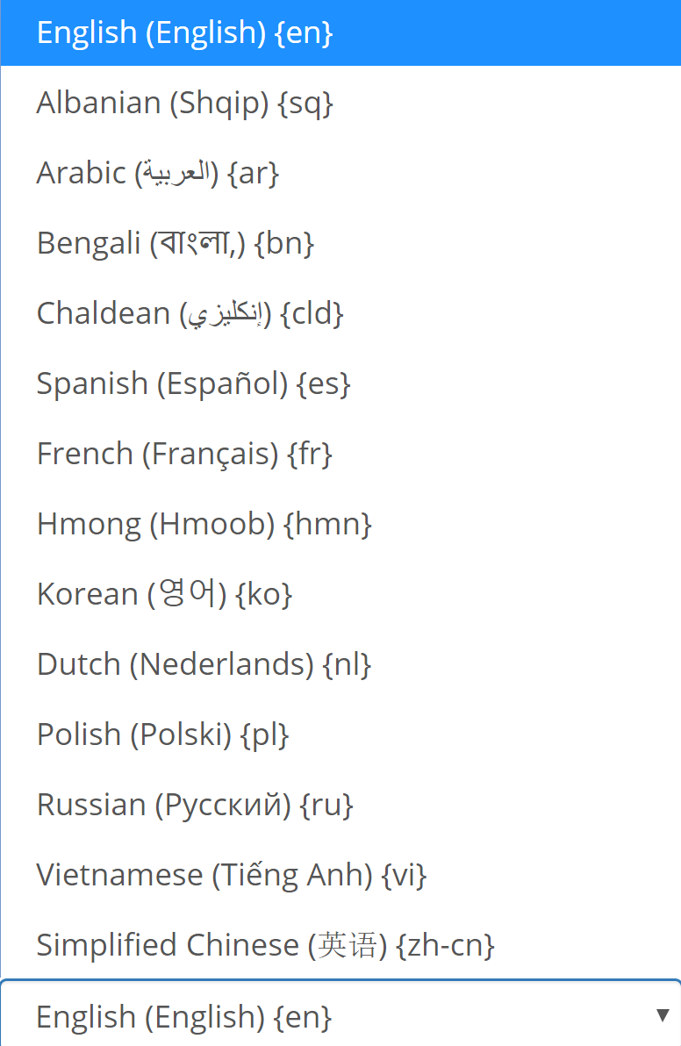
A2J Author Around the World

Slide 30
A2J Guided Interviews: IRL
Identity Theft – Letter to Creditor
Divorce
Order of Protection
Guardianship Petition
Motion to Modify Child Support
Eviction Counterclaim
Motion to Set Aside Default
Unemployment Benefits Calculator
Food Stamps Calculator
Voluntary Acknowledgement of Paternity
Delay a Foreclosure
Unpaid Wages Demand Letter

Slide 31
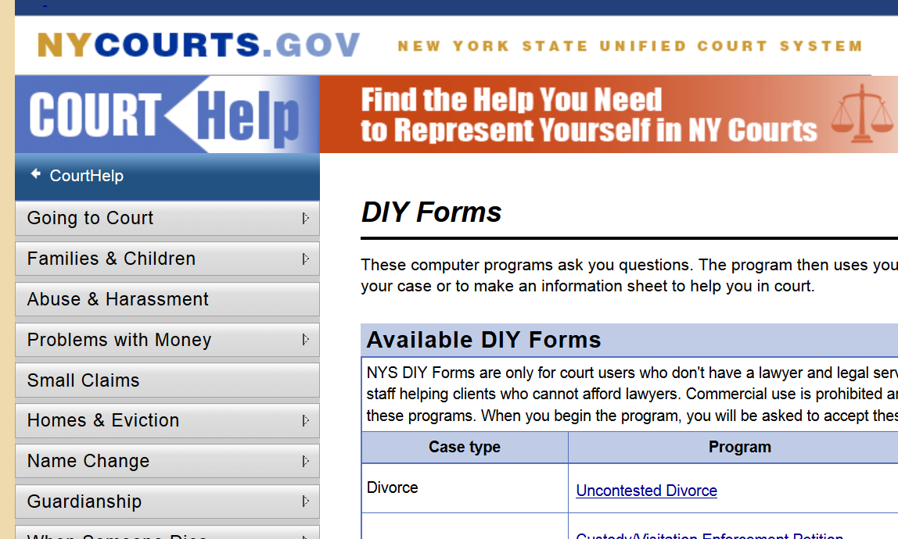
https://www.nycourts.gov/CourtHelp/DIY/index.shtml

Slide 32
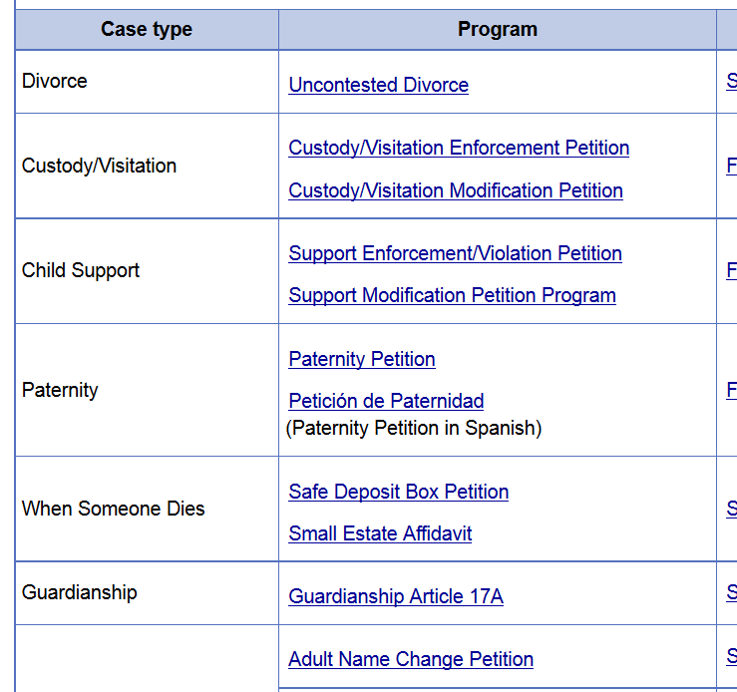
https://www.nycourts.gov/CourtHelp/DIY/index.shtml

Slide 33
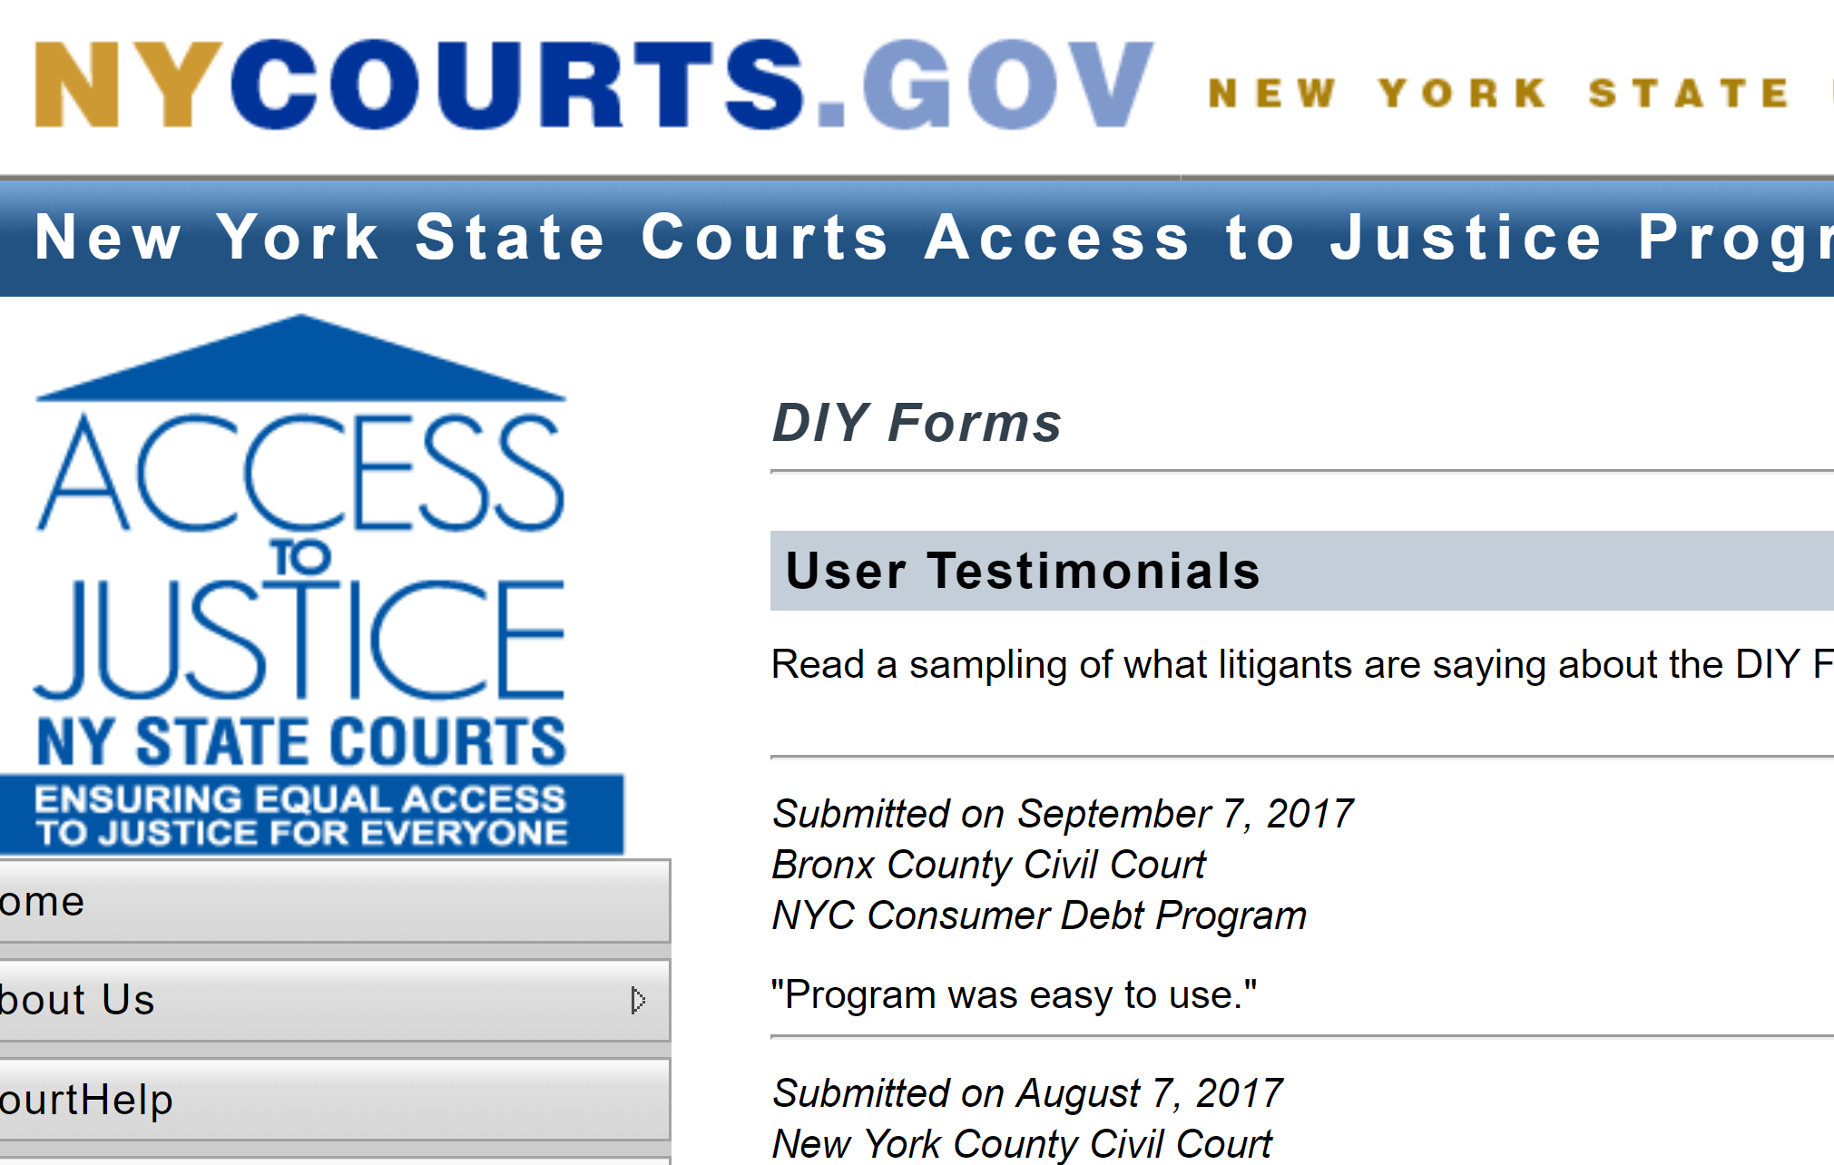
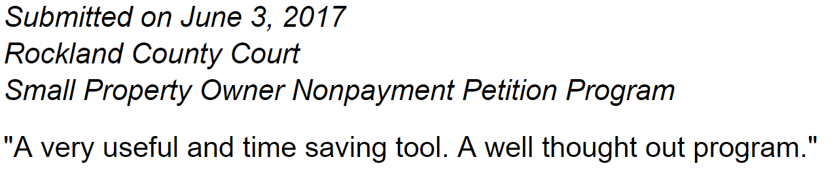
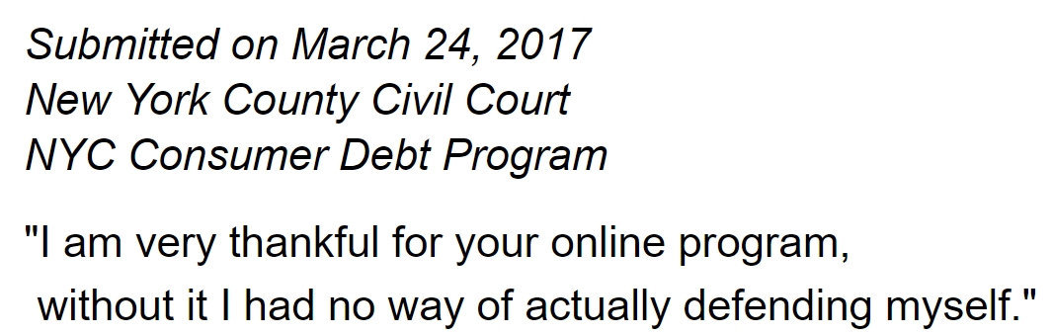
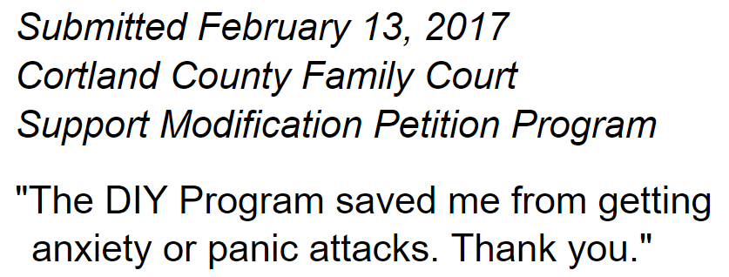
Notes:
One example - the New York Family Court uses A2J Author for several dozen different forms. They solicit feedback from users and have received thousands of comments like this. Court staff love this system too.

Slide 34
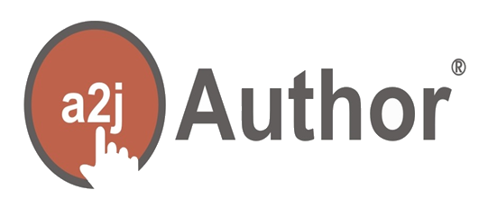
12

Slide 35
12

Slide 37
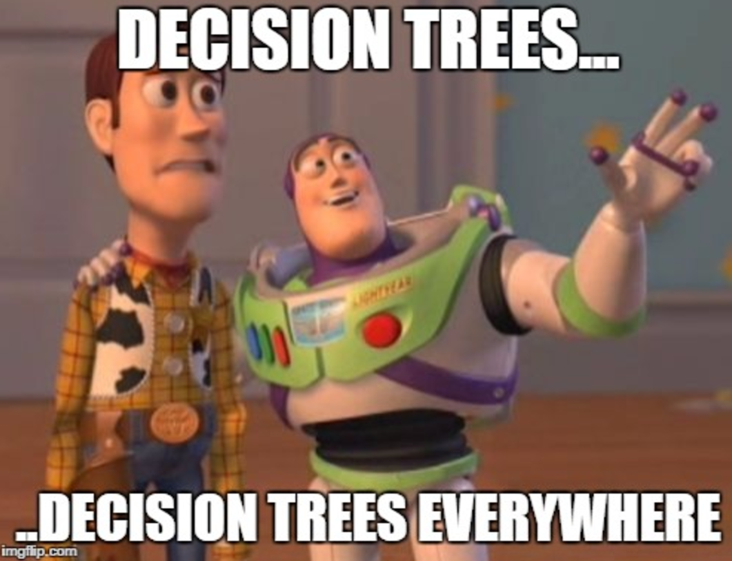
Notes:
And it wasn’t just transactional courses. There are forms, documents and decision trees all over the place in law and legal practice. The possibilities are only limited by our imaginations, but the tool has to be freely available, responsive to the problem space – we are constantly adding new features - and part of a new community of practice – practicing law through software.

Slide 38

Document Assembly
Court Forms
Benefits Calculators
Eligibility Check
Compliance
Pre Court Checklists
Online Intake
Contract Constructiom
Legal “Health” Checkups
Triage

Slide 39
Legal Education
Technology
Access to Justice
Law Practice

Slide 40
Increasingly Automated, Modular,
Systematized, Mobile, Re-entrant
and Online
Law Practice

Slide 41
Legal Education
Prepare students for 21st century
practice which uses intelligent,
ubiquitous tech.

Slide 42
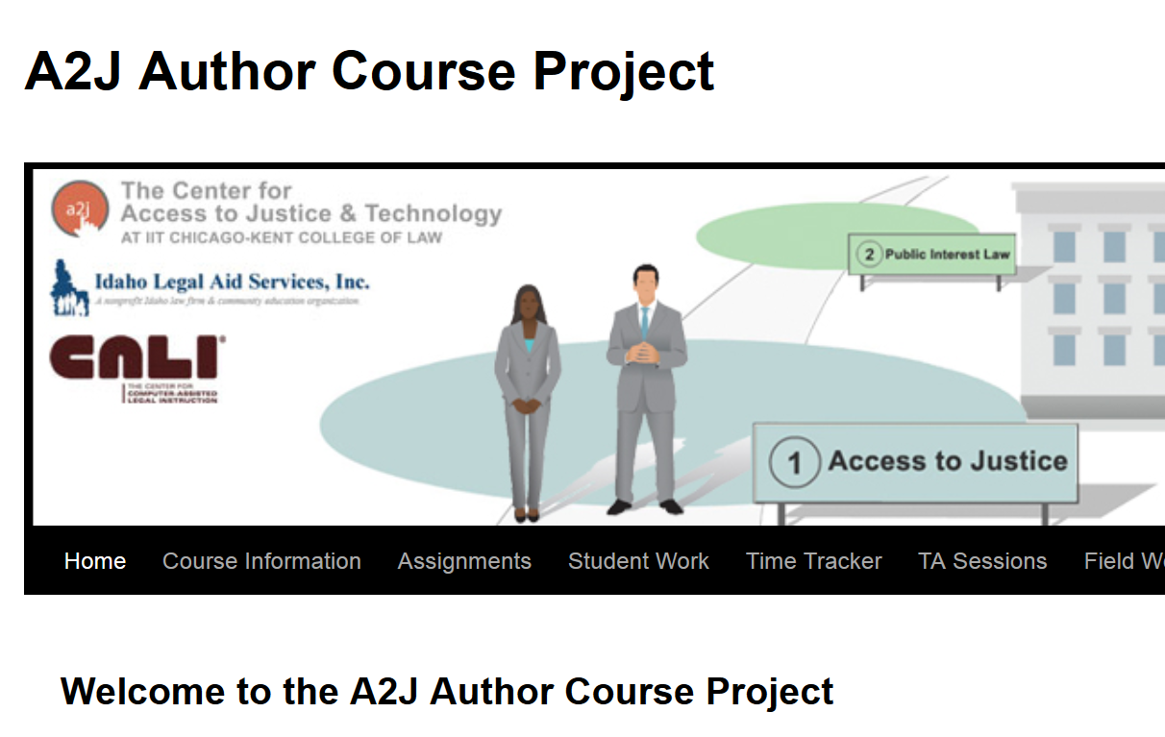
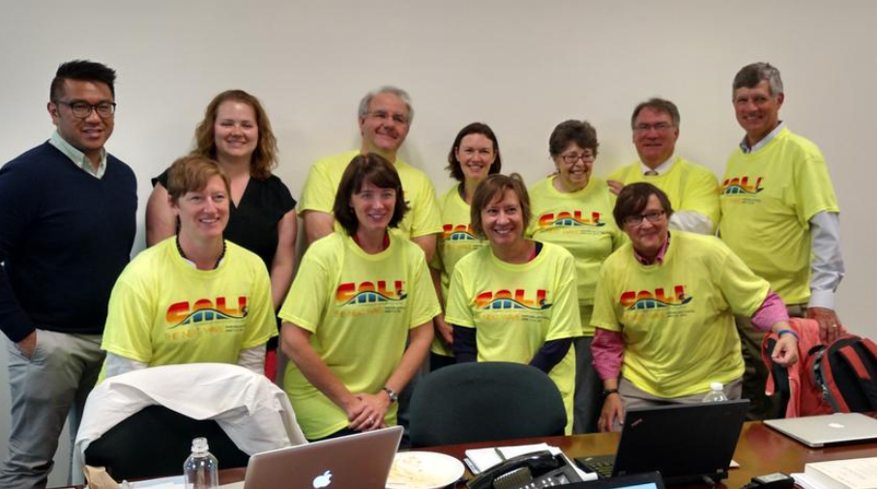
http://a2jclinic.classcaster.net/

Slide 43
Technology
Cheap, user-centered and
Non-proprietary. Mobile and
iterative innovation.

Slide 44
Justice “system” is not systematic,
transparent, open to innovation
or accessible.
Access to Justice

Slide 45
Legal Education
Technology
Access to Justice
Law Practice

Slide 46
Legal Education
Technology
Access to Justice
Law Practice

Slide 47
OPPORTUNITY
FOR
LIIs?

Slide 48
Access to the law is only the beginning.

Slide 49
Access to the law is only the beginning.
Forms, Processes, Decision Trees, Chatbots…
… provide a path to Access to Justice

Slide 50
www.
.org
Sign up for an account and look around
Road Map
Hosted A2J Guided Interviews for ANYONE doing access to justice
Mobile friendly (built in)
Document Assembly tool
Analytics / Dashboards for Authors
Continued Free training and support
Jessica@cali.org

Slide 51
www.
.org
Tools for a focused community of sharing and innovation

Slide 52
John Mayer
Executive Director
CALI jmayer@cali.org
@johnpmayer
JOIN US
Jessica Frank
A2J Project Lead
CALI
jessica@cali.org
@a2jauthor

Slide 53
John Mayer
Executive Director
CALI jmayer@cali.org
@johnpmayer
A Decade of Using Document Assembly to Facilitate Access to Justice
Jessica Frank
A2J Project Lead
CALI
jessica@cali.org
@a2jauthor

